Slide 1

Concrete Strength Prediction
Name of the Student: Ms. Bala Deepika J
Register Number: 39110112
Project Supervisor: Dr.A.C.Santha Sheela,MCA., M.E., Ph.D.,

Slide 2
Presentation Outline
Course Certificate
Introduction
Objectives
System Architecture / Ideation Map
Module Implementation
Application Snapshots
Results and Discussions
Conclusion & Future work
References

Slide 3
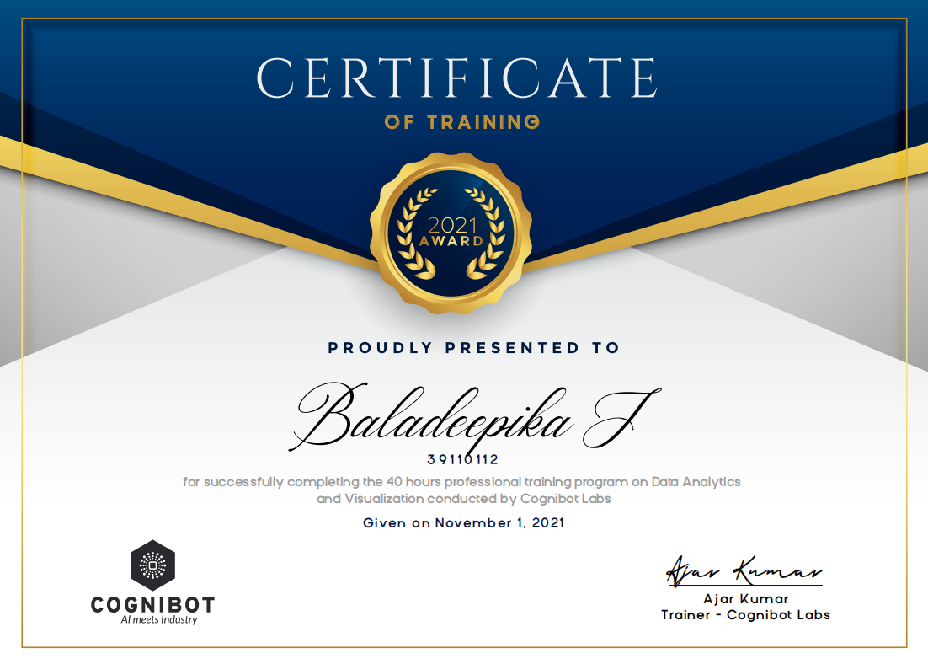
Course Certificate

Slide 4
Introduction
Concrete -- an extremely versatile use in construction , most widely used construction material in use today.
Characteristic strength of the concrete is designated as the compressive strength of a concrete sample that has been cured for 28 days and is determined by the standard cylinder crushing test. In construction works 28 days is a considerable time to wait, while it is essential for quality assurance of concrete and cannot be avoided.

Slide 5
Introduction
Statistical analysis ------- provides insights into the key factors influencing 28 days compressive strength through correlation analysis.
A very relevant problem which demands the attention of communities such as machine learning and data science
Defining the problem statement:
Create a ML model which can predict the Strength of concrete
(i)Target Variable: Strength
(ii)Predictors: water, cement, ash, days to dry etc.

Slide 6
Objectives
The main objective of Concrete Strength Prediction is to detect the strength of concrete accurately and to minimize the time consumption for Civil Engineers.
The best model will be helpful for civil engineers in choosing the appropriate concrete for bridges, houses construction.

Slide 7
SYSTEM ARCHITECTURE
System Requirements
Dataset Description
Exploratory Data Analysis
Data preprocessing
Predictor Variable
Output Predicted Variable
multiple linear regression model

Slide 8
Modules
System Requirements
Dataset Description
Exploratory data analysis
Data preprocessing
Model Generation Using multiple linear regression

Slide 9
System Requirements
Operating System : Windows OS(10/8/7)
Processor : i3 or more
Coding Language : Python
Tool : Jupyter Notebook
Libraries : pandas, matplotlib, sklearn, numpy, seaborn

Slide 10
Dataset Description
In this project we will be using the Concrete Compressive Strength data set.
The dataset consists of 1030 instances with 9 attributes and has no missing values.
There are 8 input variables and 1 output variable.
Seven input variables represent the amount of raw material (measured in kg/m³) and one represents Age (in Days).
The target variable is Concrete Compressive Strength measured in (MPa — Mega Pascal).

Slide 11
Exploratory Data Analysis
The first step in a Data Science project is to understand the data and gain insights from the data before doing any modelling.
This includes checking for any missing values, plotting the features with respect to the target variable, observing the distributions of all the features and so on.

Slide 12
Exploratory Data Analysis
EDA is an important step to build any machine learning project, it is an approach of analyzing datasets to summarize their main characteristics.
With the help of EDA, we can able to take knowledge of features by just observing the plots and graphs.

Slide 13
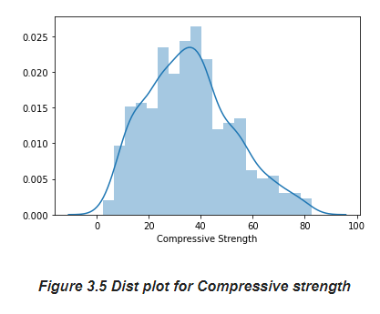
Data Pre-processing
Study Dataset
Dist plot for compressive strength

Slide 14
Data Pre-processing
Dividing Dependent and Independent Variables
Before starting model building we have to divide the dataset into two parts
i Independent variables contain a list of those variables in which concrete quality is dependent.
Ii The dependent variable is that variable that is dependent on other variables’ values.
In this program, x contains the list of independent variables, and y contains the dependent variable in this case
i. Independent variables are cement, fly ash, water, Superplasticizer, coarse aggregate, fine aggregate, age.
ii. dependent variable is the only csMPa

Slide 15
Data Pre-processing
Splitting the data
Now we use the scikit-learn module train_test_split, which is used for splitting the training and testing parts.
Handling Null values
Now, we handle the null values that are present in the dataset for better accuracy

Slide 16
Model Generation Using multiple linear regression
After preparing the data, we can fit different models on the training data and compare their performance to choose the algorithm with good performance.
Machine learning consists of algorithms that can automate analytical model building.
Using algorithms that iteratively learn from data. In this step, we applying several machine learning algorithms to training data. As this is a regression problem, we can use RMSE (Root Mean Square Error) and R² score as evaluation metrics.

Slide 17
Model Generation Using multiple linear regression
Linear Regression (LR) Linear regression is an old method to evaluate the correlation between two or more features.
After deciding the relationship between features (input) and target (output), the learning process will be run to minimize the loss function value (like Mean Squared Error).
The parameters that minimize the loss function are exactly the optimal parameters for the regression.
The general form of a multiple linear regression model is yˆ = a0 + m ∑ j = 1 ajXj

Slide 18
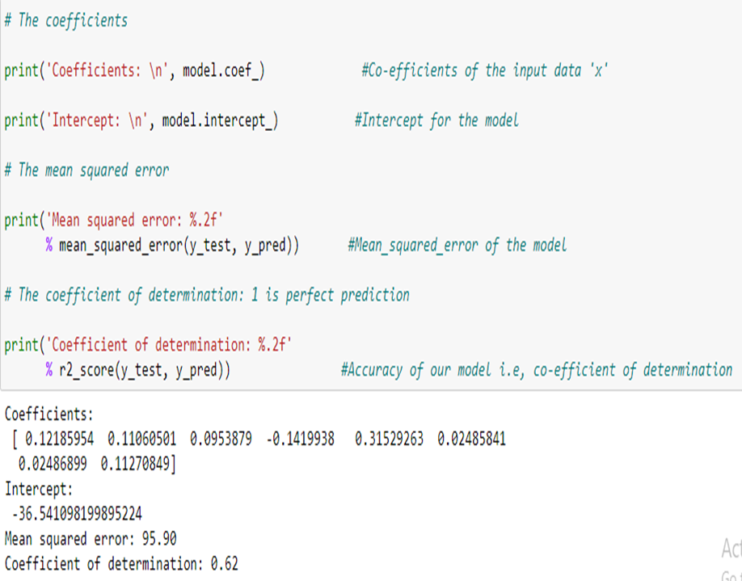
Application snapshots

Slide 19
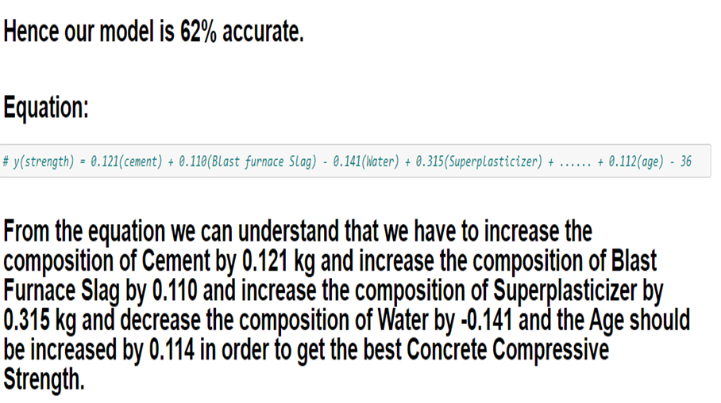
Application snapshots

Slide 20
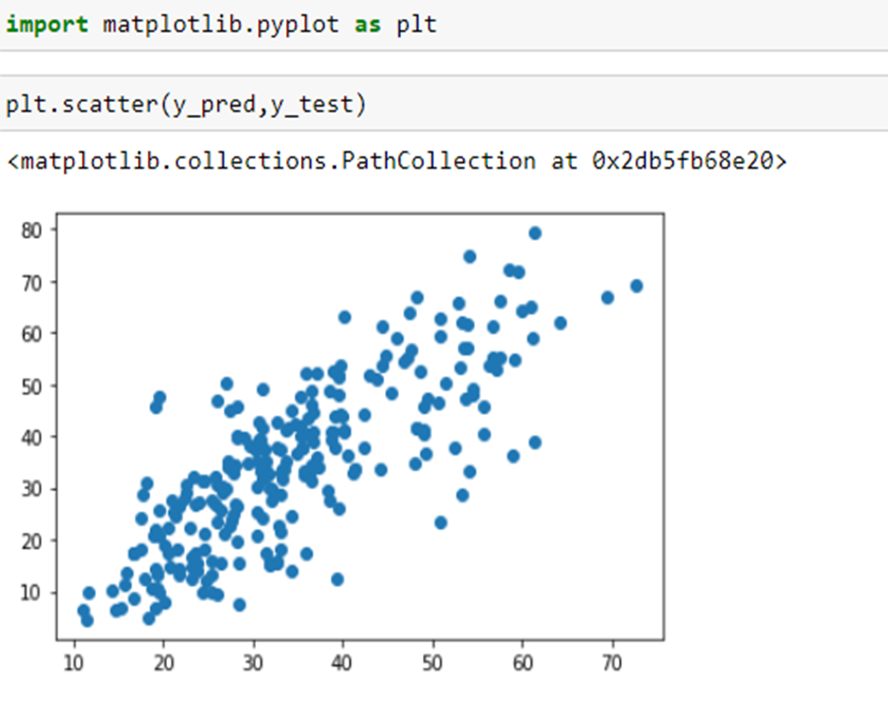
Application snapshots

Slide 21
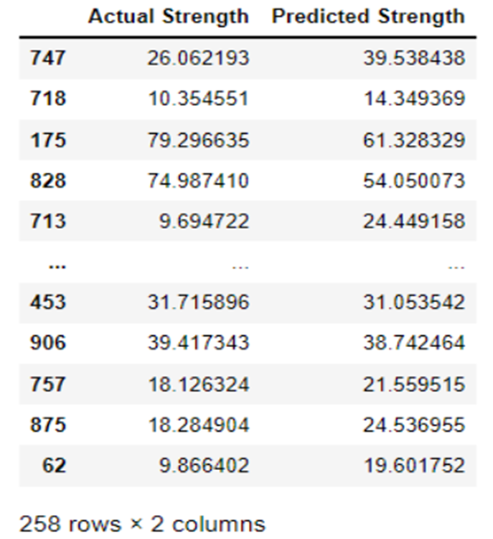
Results and Discussion
Predicted Values vs Original Values
Now, we take a comparison between the predicted values of the dependent variable csMPa and the original values of variable csMPa.

Slide 22
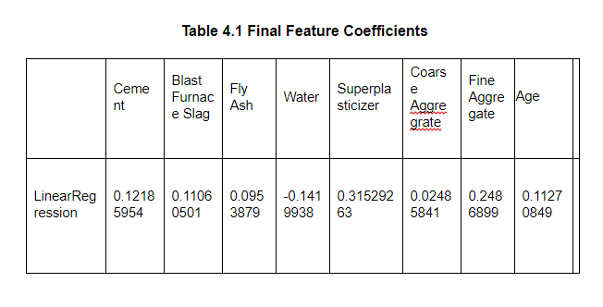
Results and Discussion
Final Feature Coefficient

Slide 23
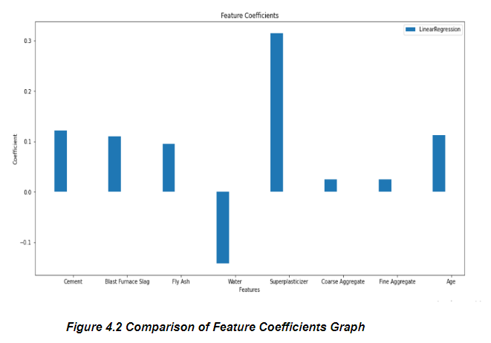
Results and Discussion
Let's see how each model values each feature by visualizing the coefficients:
Comparison of feature coefficient graph

Slide 24
Results and Discussion
The performance measuring statistical parameters like Root Mean Square Error and ratio of prediction to actual values are used to check the efficiency of the proposed model for every group of data sets.
Scoring metrics
Although all of our models have performed similarly, it depends on which scoring metric you look at the determine the overall winner. Let's explore the different scoring metrics.
Root Mean Square Error (RMSE)
RMSE is the square root of the error function that the regression algorithms are trying to reduce. It is an absolute measure of how well the model fits the data.

Slide 25
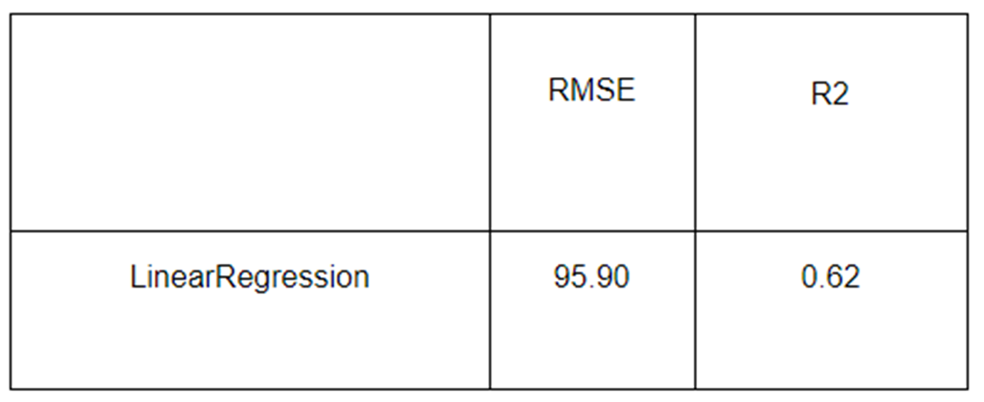
Results and Discussion
R Square
R Square measures how much variability in a dependent variable can be explained by the model. It is a good metric to determine the fit on dependent variables. But, it does not take into consideration overfitting.
Scoring metrics

Slide 26
Conclusion
Cement, age and super plasticizer have a positive impact on the overall strength.Water is found to have a negative impact, but is often present in older concrete due to the curing processes.
These insights are not intuitive and could be profound and beneficial in a business context.
There is a clear opportunity for digital simulation to reduce wait time and total number of combinations. With the data set acquired we can learn about the relations between variables and develop a predictive model.
Highlighting potentially optimal combinations to then be used in physical testing will provide enormous benefit and significantly reduce the labor and testing costs.

Slide 27
References
[1] | Kiambigi, Maina, Gwaya, A.O, Koteng, D.O, “Concrete Strength Prediction using MultiLinear Regression Model: A case study of Nairobi Metropolitan”, International Journal of Soft Computing and Engineering (IJSCE), Volume 8, Year 2019, Pages 11-20
[2] | Jee Namyong, Yoon Sangchun & Cho Hongbum, “Prediction of Compressive Strength of In-Situ Concrete Based on Mixture Proportions”, Journal of Asian Architecture and Building Engineering, Vol. 3, Year 2018, Pages 9-16
[3] | Phijo J Cherickal, Vidhya V Kumar, Ranjini Mariam Philipose, Shailesh S, Tiji Thomas, “Compression Strength Prediction Using Machine Learning Techniques”, International Journal of Advanced Trends in Computer Science and Engineering, Vol. 10, No.1, Year 2021, Pages 301-307
[4] | P. Silva, G. Moita and V. Arruda, “Machine Learning techniques to predict the Compressive Strength of Concrete”, International Journal of Numerical Methods for Calculation and Design in Engineering (RIMNI), Vol. 36, Year 2020, Pages 1-48

